Slide 1
LSTM Production Forecasting
By Cooper Smidt and Chuck Agu

Slide 2
Objective
Select wells to forecast production
Run LSTM model to predict production
Optimize LSTM model
Compare “adam” optimizer and “stochastic gradient decent” optimizer

Slide 3
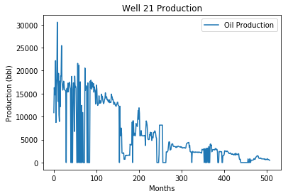
Well Selection
Arbitrarily selected the Euler field in the Athena formation
Looking for well with a relatively high amount of data
Looking for well with “normal” looking decline
Selected well 21

Slide 4
The Algorithm
Function | Purpose
timeseries_to_supervised | creates a separate column offset by 1 and concatinates it with the original
difference | Takes a difference within a column
inverse_difference | Reverts the difference
scale | Scales the training and testing datasets for the activation function
invert_scale | Reverts the scale transfomration
fit_lstm | Fits the LSTM to the training data, contains the layers of the network and the tuning parameters
forecast_lstm | Forecasts 1 time step - looped through the entire training dataset

Slide 5
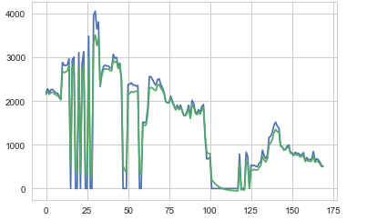
Results for Well 21
Used RMSE to see how well the model performed
This gives the standard deviation of the residuals, or how far the regression line is from the true data points
RMSE of 816 for the test set

Slide 6
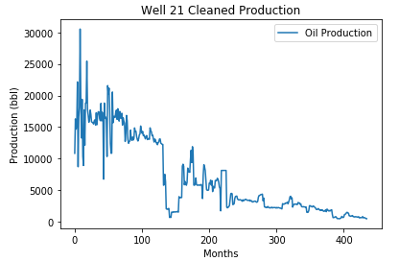
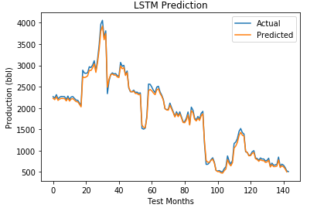
Data Cleaning and Results
Decided to remove shut-in times – 73 months of data
RMSE of 231.5 for the test set

Slide 7


Tuning the parameters
Looped the model 30 times with 18 different amounts of neurons and epochs and took average of the RMSE and the standard deviation
Hypothesized that more epochs and more neurons would yield better results, but it was not the case
Lower epochs and neurons yielded lower RMSE Means, but higher STD
Best combinations:
Worst combinations:
Epochs | Neurons | RMSE Mean | STD
3 | 4 | 231.5 | 2.95
3 | 8 | 231.28 | 2.38
1 | 10 | 231.45 | 2.32
Epochs | Neurons | RMSE Mean | STD
15 | 15 | 263.47 | 1.86
20 | 15 | 262.52 | 1.48
20 | 20 | 259.87813 | 1.0818

Slide 8
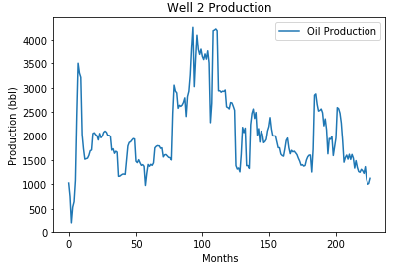
New Hypothesis
We though that if we had few shut-in times to remove, the predictions would get better
Looked for well with relatively large amount of data
Chose Well 2
Deleted only 15 months of shut-in time

Slide 9
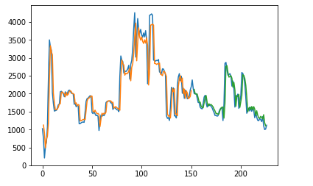

Results from Well 2
We ran the same 18 combinations of neurons and epochs for Well 21
Noticed that more epochs and neurons generally resulted in lower RMSE and STD, while less epochs and neurons resulted in a higher RMSE and STD
Best combinations:
Worst combinations
Epochs | Neurons | RMSE Mean | STD
10 | 10 | 220.79 | 1.68
20 | 15 | 219.67 | 1.34
15 | 15 | 219 | 0.79
Epochs | Neurons | RMSE Mean | STD
2 | 2 | 228.44 | 3.13
1 | 10 | 225.84 | 1.23
3 | 4 | 225.42 | 1.48

Slide 10

Testing the Stochastic Gradient Descent Optimizer
Again, we ran the same 18 combinations of neurons and epochs for Well 21, and again, we got better results with more epochs and neurons
Best combination:
Worst combination:
Epochs | Neurons | RMSE Mean | STD
8 | 8 | 223.04 | 1.76
20 | 15 | 224.03 | 1.13
20 | 20 | 224.11 | 1.19
Epochs | Neurons | RMSE Mean | STD
3 | 4 | 226.17 | 3.27
3 | 8 | 226.58 | 2.75
5 | 6 | 224.59 | 1.9

Slide 11
T-test and Assumptions
A t-test tells you if there is a significant difference between the means of 2 groups, with the null hypothesis being that there is no difference between the means
Assumptions
Bivariate independent variables
Tuning parameters
Continuous depended variables
RMSE
Each observation of the dependent variable is independent of the other observations of the dependent variable
True
Dependent variable has a normal distribution, with the same variance
Seems close

Slide 12
T-Test between Adam and SGD optimizers
We ran t-test on the mean RMSE and the variance of the RMSE between the the groups using the Adam optimizer and the Stochastic Gradient Decent optimizer
Mean RMSE t-test results:
p = .0149, reject the null hypothesis
Variance of RMSE of t-test results:
P = .0111, reject the null hypothesis
There was a statistical difference between how well the model performed using the Adam optimizer and the Stochastic Gradient Decent optimizer
Using the Adam optimizer may be the best to use for forecasting production decline

Slide 13
Going Forward
We realized we failed to report the training RMSE
We need this data to determine the fitness of the model
Plan on rerunning the model, and selecting epochs at magnitudes of difference

Slide 14
Appendix
http://www.csic.cornell.edu/Elrod/t-test/t-test-assumptions.html
https://machinelearningmastery.com/time-series-forecasting-long-short-term-memory-network-python/

Slide 15
ADDITION TO PRESENTATION

Slide 16
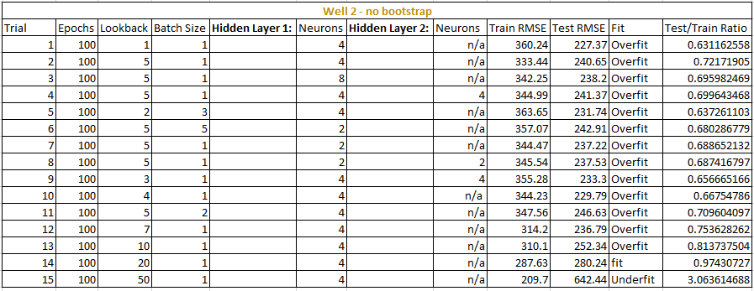


Tuning Well 2, not Bootstrapped
Trial number 14 generated the best fit model, with 20 lookbacks, 1 hidden layer, and a batch size of 1

Slide 17
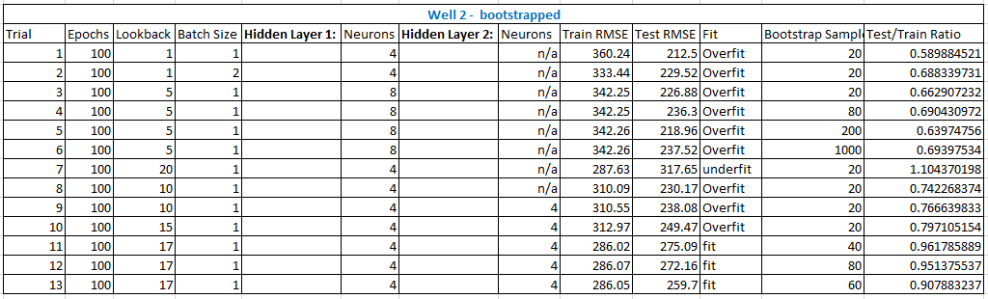
Tuning Well 2, Bootstrapped
Trial numbers 11-13 generated a fit model, and trial number 13 achieved the lowest RMSE score

Slide 18
Conclusion
We went back and fit the LSTM model
The threshold for a fit model was a test RMSE to train RMSE ratio > .9
We fit the LSTM model for Well 2 with 33% of the training data, and we bootstrapped the data to increase the test size
The training dataset was increased by 26%, yielding a fit model with the lowest error score

